Slide 1
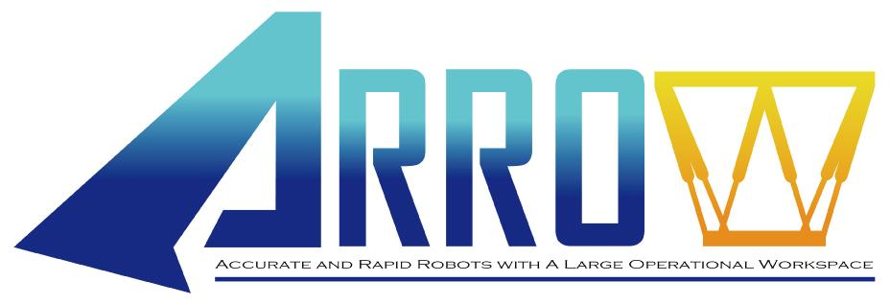
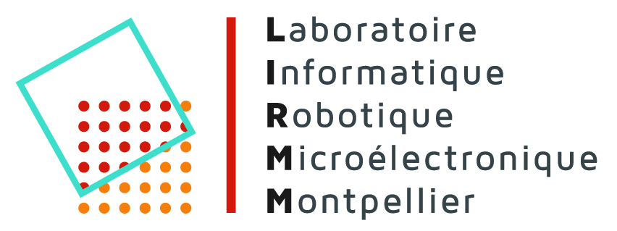
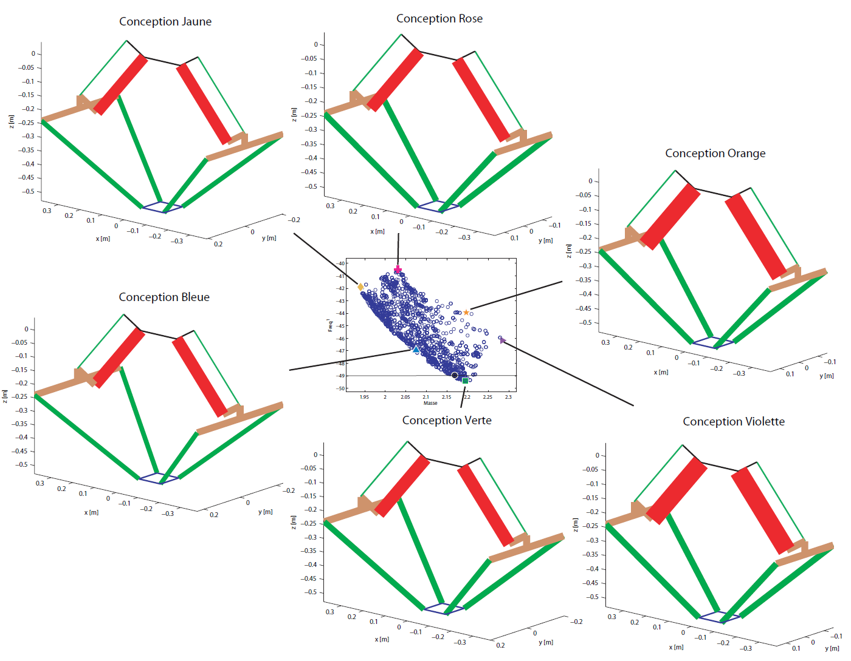
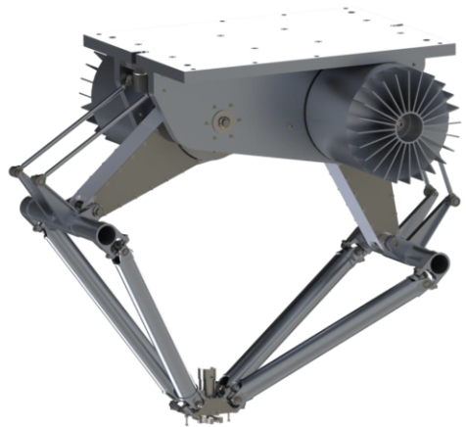
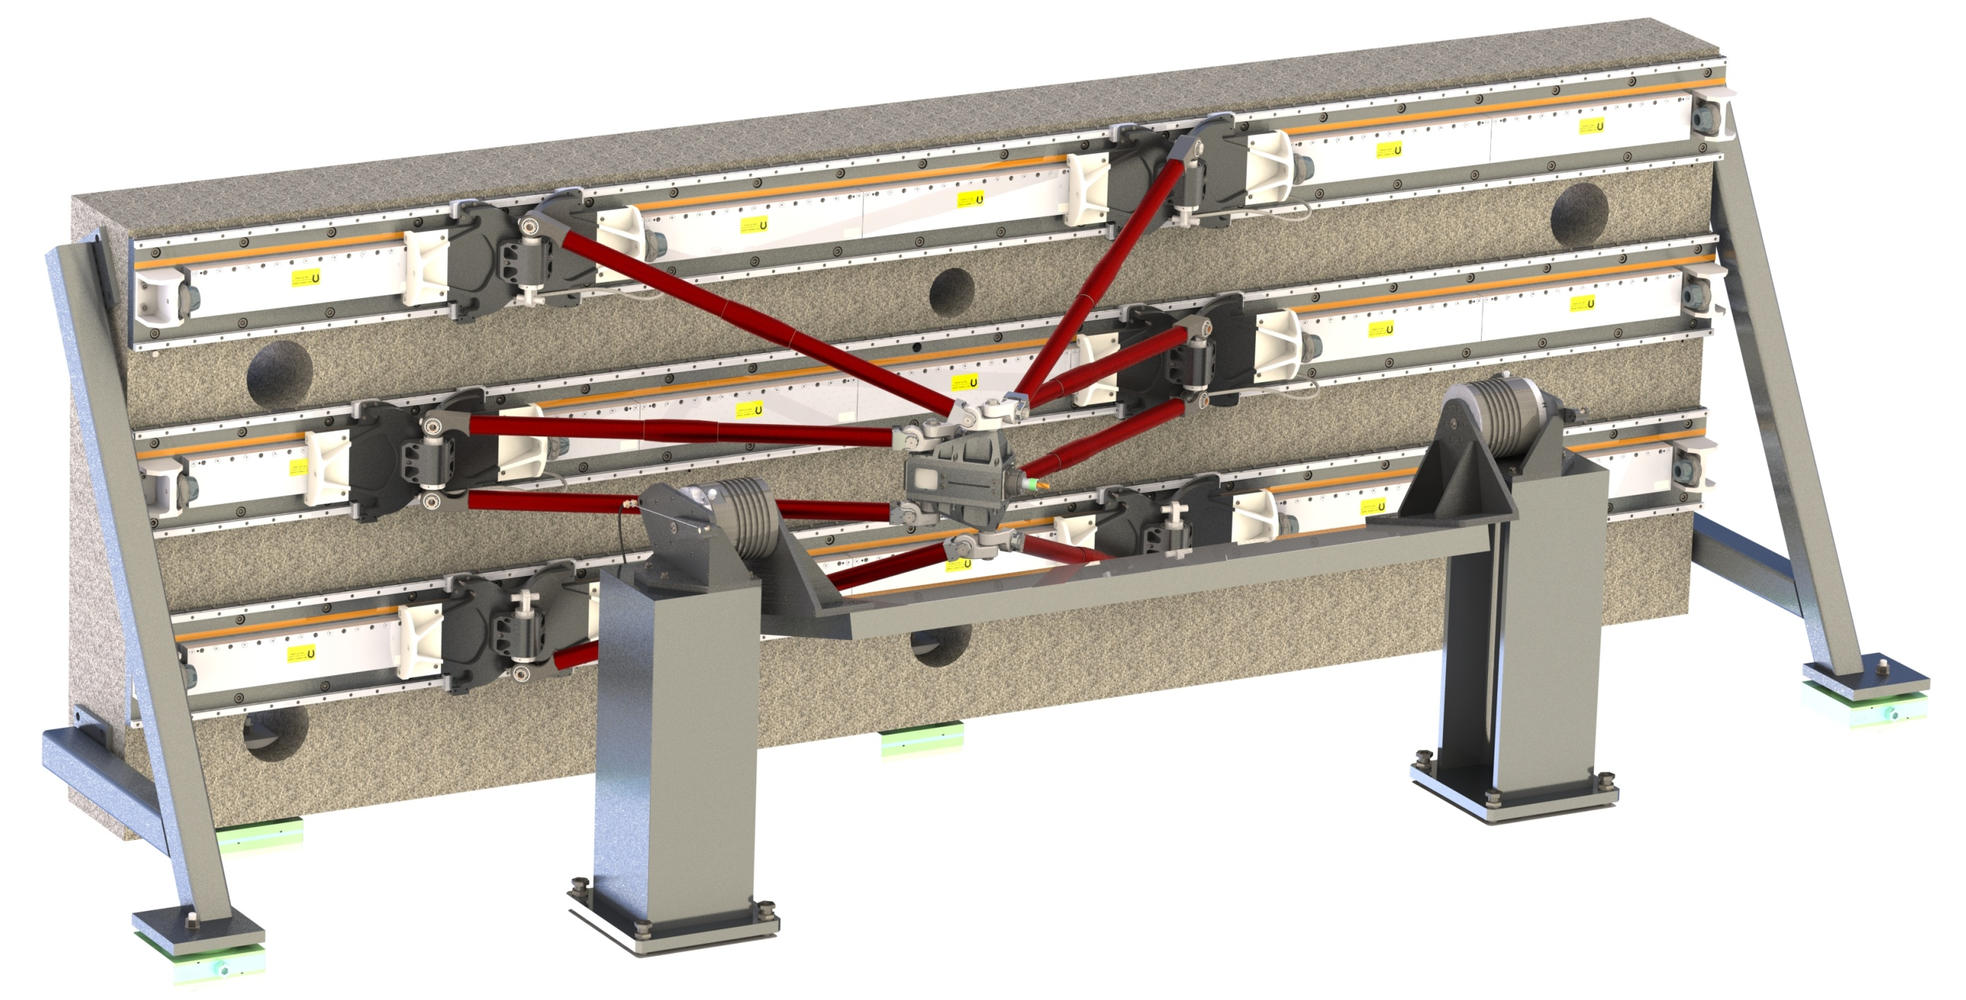
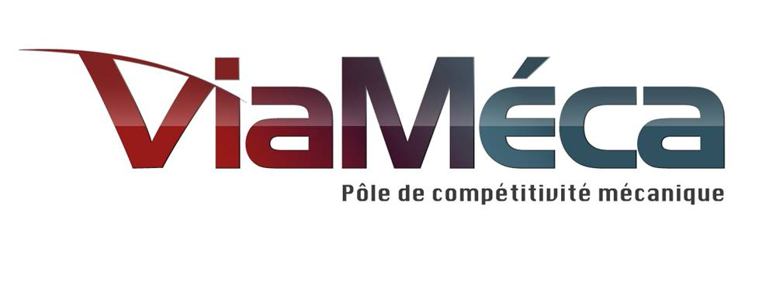
Project ID: ANR-11-BS03-0006
Starting: October 15, 2011
End: October 14, 2015
Funding: 823,000 €
Nb of partners: 3
Takes part in the EquipEx RobotEx
Objectives: to design and to build industrial robots that are able to reach 20g of acceleration with an absolute accuracy of 20µm in a 1m large workspace.
Two Research Axes: robot design and advanced control
(with the use of control-based design criteria within the design process)
Two Application Cases: Pick-and-Place operations and milling of soft materials
Development of a Robot for Pick-and-Place Operations (IRCCyN / Tecnalia)
Specifications: 3 dof robot (Tx Tz Rz)
Robot Design Approach
2T Parallel robot + motor mounted on the platform (Rz)
Definition of a new 2T parallel robot (IRSBot-2 – patented) with a spatial architecture (stiffer)
Development of a task-oriented optimal design methodology
CAD drawings of the prototype
Prototype will be delivered in September 2014
Simulated behavior (with CAD)
First nat. frequencies: 45Hz (Ty) / 55Hz (Tx Tz)
Deformations (Fy=20N): 136µm
Peak / Mean torque: 250Nm / 120 Nm
Development of a 5-Axis Fast Robot for Milling Pockets in Long Parts (LIRMM/ Tecnalia)
Specifications
Left hand-right hand paradigm (3T1R // module + 1R pivoting table)
Redundantly actuated (6 act./4 dof // module + pivoting gantry)
1m long elongated workspace
Design Approach
Multi-criteria optim. (acceleration capability vs. precision)
Conceptual design with practical realization in mind (non-concentric universal joints)
Control
Development of a simulator of the robot
Different control approaches implemented
Adaptive controllers give the best results
Next: Real-time application on the prototype
Prototype in April 2014

